Slide 1
Outlier Detection in Noisy and Unlabeled Data
Identifying anomalies within complex data environments
A.E. Rodriguez
THE UNIVERSITY OF NEW HAVEN
Notes:
AI-generated content may be incorrect. ---

Slide 2
Foundations and Motivation
Notes:
--- This slide references information from the following file: https://arods-docs.site44.com/reject.pptx Why Outlier Detection Matters in Applied Analytics, Distinguishing Outliers, Noise, and Rare Events

Slide 3

Why Outlier Detection Matters in Applied Analytics
Significance of Outliers
Outliers often carry critical information like fraud, errors, or rare impactful events in professional analytics.
Impact on Statistical Models
Ignoring outliers can bias estimates and degrade predictive performance in regression and machine learning models.
Detection Challenges
Large, noisy datasets and lack of labels require unsupervised techniques and domain knowledge for effective outlier detection.
Strategic Value
Outlier detection prioritizes investigative focus, improves decision-making, and integrates into accountable data pipelines.
Notes:
--- This slide references information from the following file: https://arods-docs.site44.com/reject.pptx Outlier detection plays a central role in applied analytics because extreme or unusual observations often carry the most consequential information in real-world datasets. In many professional domains—such as forensic accounting, compliance auditing, healthcare analytics, and public-sector administration—outliers are not simply random noise or data entry errors. Instead, they may represent fraud, misreporting, procedural breakdowns, or rare but impactful events that deserve careful scrutiny. For example, in Medicaid audits, unusually high reimbursement claims or atypical billing patterns may signal misclassification or abuse rather than clerical mistakes. Treating these observations as disposable noise can therefore undermine the very purpose of the analysis. At the same time, outliers can severely distort statistical estimates and machine learning models when they are left unexamined. Linear regression coefficients, covariance estimates, and distance-based algorithms are all sensitive to extreme values, which can lead to biased inference and poor predictive performance. This dual nature of outliers—as both a threat to model validity and a potential source of insight—creates a fundamental tension. Effective outlier detection seeks to manage this tension by identifying observations that merit further investigation without reflexively discarding them. Modern data environments intensify this challenge. Large administrative datasets are often noisy, heterogeneous, and weakly governed, while labels identifying “normal” versus “abnormal” behavior are typically unavailable. In such settings, analysts must rely on unsupervised techniques and domain knowledge rather than predefined rules. The motivation for studying outlier detection, therefore, extends beyond technical curiosity. It is about building disciplined, transparent processes for prioritizing attention, allocating investigative resources, and improving downstream modeling decisions. When used thoughtfully, outlier detection becomes an integral component of a broader data pipeline that links raw data to accountable, real-world decisions.

Slide 4

Distinguishing Outliers, Noise, and Rare Events
Understanding Noise
Noise represents random errors or variations without meaningful patterns that should be filtered or smoothed.
Identifying Outliers
Outliers are systematic deviations differing structurally from the majority, caused by failures or unusual behavior.
Recognizing Rare Events
Rare events are infrequent but valid phenomena, important for analysis despite resembling outliers statistically.
Analytical Framework Importance
Effective detection requires contextual interpretation beyond statistics, considering consequences and data provenance.
Notes:
--- This slide references information from the following file: https://arods-docs.site44.com/reject.pptx A critical conceptual step in outlier detection is distinguishing among noise, outliers, and rare but valid events. Noise refers to random measurement error or stochastic variation that does not reflect any underlying structure in the data-generating process. Examples include minor recording inaccuracies, rounding error, or transient sensor glitches. Such noise is typically uninformative and, when possible, should be smoothed or filtered. Outliers, by contrast, are systematic deviations from the prevailing pattern of the data. They are not merely extreme values, but observations that differ in kind or structure from the majority. These deviations may arise from process failures, misclassification, unusual behavior, or institutional changes. Rare events occupy a third category. They may look like outliers statistically, yet they represent legitimate phenomena that occur infrequently but are substantively important, such as catastrophic losses, major fraud cases, or rare medical conditions. The danger in practice is that automated procedures often conflate these categories. A purely statistical rule may flag a rare but meaningful observation as an error, while ignoring a subtle but systematic anomaly embedded within noisy data. In audit and forensic contexts, this confusion can be costly, leading analysts to overlook high-risk cases or waste resources chasing innocuous anomalies. Effective outlier detection therefore requires more than numerical thresholds. It demands an interpretive framework that considers data provenance, institutional context, and the consequences of different types of errors. Analysts must continually ask whether an unusual observation represents something to be corrected, something to be modeled differently, or something to be investigated more deeply. This perspective reinforces the idea that outlier detection is not an end in itself, but a decision-support tool embedded within a larger analytical and organizational process.

Slide 5
Classical Statistical Approaches
Notes:
Distributional Thinking and Early Detection Methods, Z-Scores and Standard Deviation Rules, Interquartile Range and Robust Univariate Rules

Slide 6
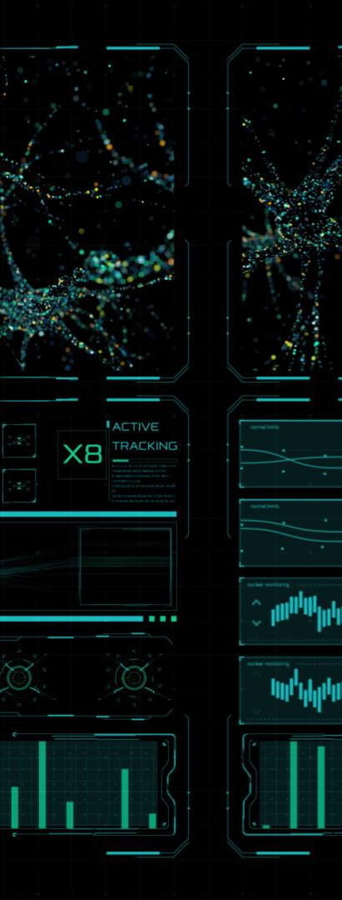
Distributional Thinking and Early Detection Methods
Classical Distributional Framework
Outlier detection relies on data modeled by parameters like mean and variance within a probabilistic distribution.
Visual Detection Techniques
Histograms, boxplots, and probability plots are early tools for identifying unusual data points in small samples.
Limitations of Classical Methods
Classical methods assume univariate, normal data, which may fail for skewed or multimodal real-world datasets.
Foundation for Advanced Methods
Understanding classical techniques helps transition to modern multivariate and machine learning based outlier detection.
Notes:
Classical approaches to outlier detection are grounded in distributional thinking, where data are assumed to arise from a well-defined probabilistic model characterized by parameters such as a mean and variance. Under this framework, outliers are observations that fall improbably far from the center of the distribution. This perspective has deep roots in statistics and remains influential because of its simplicity and interpretability. Techniques such as visual inspection of histograms, boxplots, and probability plots are often the first tools analysts use to assess unusual behavior. These methods work reasonably well in small samples and in settings where the assumed distribution—often normal—is approximately correct. However, real-world data frequently violate these assumptions. Administrative and economic datasets are commonly skewed, heavy-tailed, or multimodal, making simple parametric rules unreliable. Moreover, classical techniques are primarily univariate, examining one variable at a time. In modern applications, anomalies often emerge from complex interactions among multiple features rather than from extreme values along a single dimension. Despite these limitations, classical methods play an important pedagogical role. They provide intuition about what it means for an observation to be unusual and highlight the dependence of outlier detection on assumptions about variability and scale. Understanding these foundations also helps analysts recognize when such methods are inappropriate and motivates the transition to more flexible, multivariate, and assumption-light approaches found in unsupervised machine learning. Thus, classical methods are best viewed as a starting point rather than a comprehensive solution.

Slide 7

Z-Scores and Standard Deviation Rules
Z-Score Basics
Z-scores quantify how many standard deviations an observation is from the mean, aiding outlier detection.
Heuristic Outlier Rules
Observations with absolute z-scores above 2 or 3 are commonly flagged as potential outliers for further analysis.
Limitations of Z-Scores
Mean and standard deviation sensitivity to outliers can mask anomalies and yield false positives in skewed data.
Need for Multivariate Techniques
Z-scores analyze variables univariately, missing anomalies apparent only in combinations of variables.
Notes:
Z-scores operationalize classical outlier detection by standardizing observations relative to the sample mean and standard deviation. An observation’s z-score measures how many standard deviations it lies from the mean, providing a unit-free way to assess extremeness. Common heuristic rules classify observations with absolute z-scores above two or three as potential outliers. The appeal of this method lies in its simplicity, transparency, and ease of implementation. In approximately normal data, z-scores have a clear probabilistic interpretation that aligns with intuition. However, this approach has important weaknesses. Because both the mean and standard deviation are sensitive to extreme values, the presence of outliers can mask themselves by inflating the very statistics used to detect them. In skewed or heavy-tailed distributions, large z-scores may be common rather than exceptional, leading to excessive false positives. Z-scores are also inherently univariate, ignoring relationships among variables that may define anomalous behavior in higher dimensions. For example, an observation may appear unremarkable on each variable individually, yet be highly unusual when variables are considered jointly. In applied work, z-scores can still be useful as a quick diagnostic or as part of an exploratory analysis, but they should rarely be the sole basis for decision-making. Their limitations underscore the need for robust and multivariate techniques in contemporary data analysis.

Slide 8
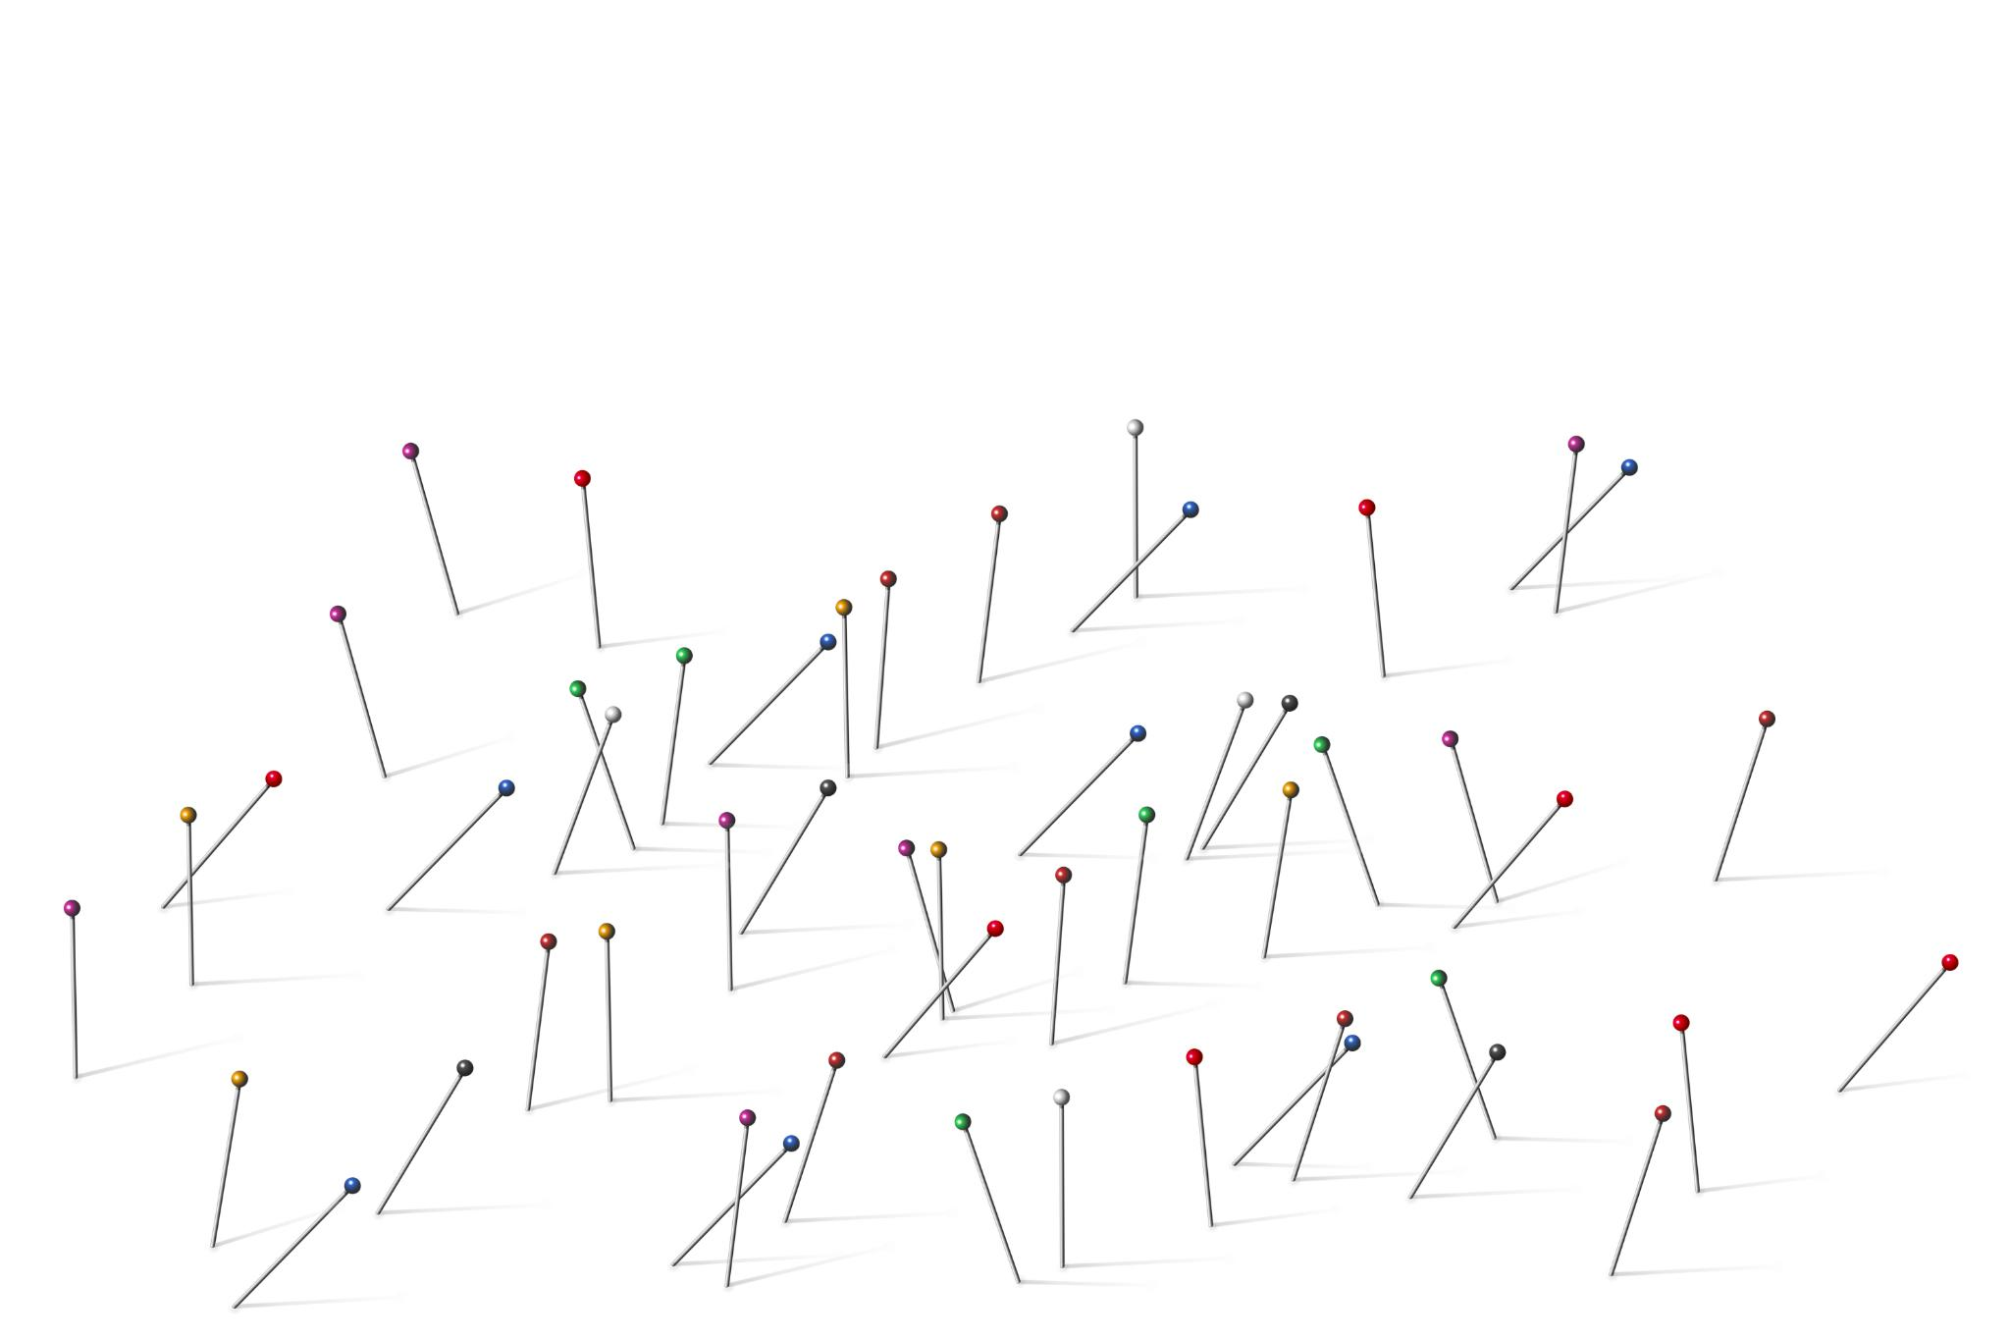
Interquartile Range and Robust Univariate Rules
Robustness of IQR Method
IQR focuses on middle 50% of data, reducing influence of extreme values and handling skewed distributions well.
Outlier Detection Rule
Observations outside 1.5 times IQR from quartiles are flagged as outliers, aiding exploratory data analysis.
Limitations in Multivariate Data
IQR method is univariate and cannot detect anomalies based on relationships across multiple variables.
Heuristic Multiplier and Use
The 1.5 multiplier is heuristic; the IQR method is best for exploratory analysis, not definitive filtering.
Notes:
The interquartile range (IQR) method offers a more robust alternative to z-scores by relying on quantiles rather than moments. By focusing on the middle 50 percent of the data, the IQR is less influenced by extreme values, making it better suited for skewed distributions. Observations falling below the first quartile minus 1.5 times the IQR or above the third quartile plus the same amount are commonly flagged as outliers. This rule is widely used in boxplots and exploratory data analysis because it is easy to compute and visually intuitive. The robustness of the IQR method makes it attractive in preliminary screening, particularly when the data include obvious extremes. Nevertheless, it remains fundamentally univariate and does not account for relationships across variables. In multivariate datasets, anomalies often manifest through unusual combinations of otherwise typical values, which the IQR rule cannot detect. Additionally, the choice of the multiplier (commonly 1.5) is heuristic and may not align with the substantive costs of false positives and false negatives in a given application. As with z-scores, the IQR method is best used as an exploratory tool rather than a definitive filter. Its main value lies in building intuition about data spread and highlighting the limitations of univariate thinking in complex analytical settings.

Slide 9
Unsupervised Machine Learning Methods
Notes:
--- This slide references information from the following file: https://scikit-learn.org/stable/modules/outlier_detection.html Why Outlier Detection Is an Unsupervised Problem, Density-Based Detection and Local Outlier Factor, Isolation Forests and Partition-Based Logic

Slide 10

Why Outlier Detection Is an Unsupervised Problem
Lack of Labeled Anomalies
Outlier detection is unsupervised because labeled anomaly examples are often unavailable or unreliable in real-world data.
Reliance on Data Structure
Unsupervised methods detect outliers by analyzing deviations from normal data patterns without predefined labels.
Exploratory and Iterative Approach
Outlier detection requires iterative analysis and domain knowledge to interpret ambiguous and variable algorithm results.
Notes:
--- This slide references information from the following file: https://scikit-learn.org/stable/modules/outlier_detection.html In most real-world applications, outlier detection must be approached as an unsupervised learning problem because labeled examples of anomalies are unavailable or unreliable. Organizations rarely possess comprehensive ground truth identifying which observations are truly abnormal, fraudulent, or erroneous. Even when labels exist, they may reflect past investigative priorities rather than objective reality. As a result, supervised classification methods are often infeasible or misleading. Unsupervised outlier detection instead relies on the internal structure of the data to identify observations that deviate from prevailing patterns. This approach reframes the task from predicting a known outcome to characterizing what constitutes typical behavior. The absence of labels, however, introduces ambiguity. There is no single, correct definition of an outlier, and different algorithms may highlight different aspects of abnormality. This variability is not a flaw but a reflection of the complexity of the problem. Analysts must therefore treat unsupervised outlier detection as an exploratory and iterative process rather than a one-shot solution. Algorithmic results should be interpreted in light of domain knowledge, data quality considerations, and the intended use of the findings. Recognizing outlier detection as an unsupervised problem encourages humility about model outputs and emphasizes the importance of transparency, sensitivity analysis, and human judgment in analytical workflows.

Slide 11
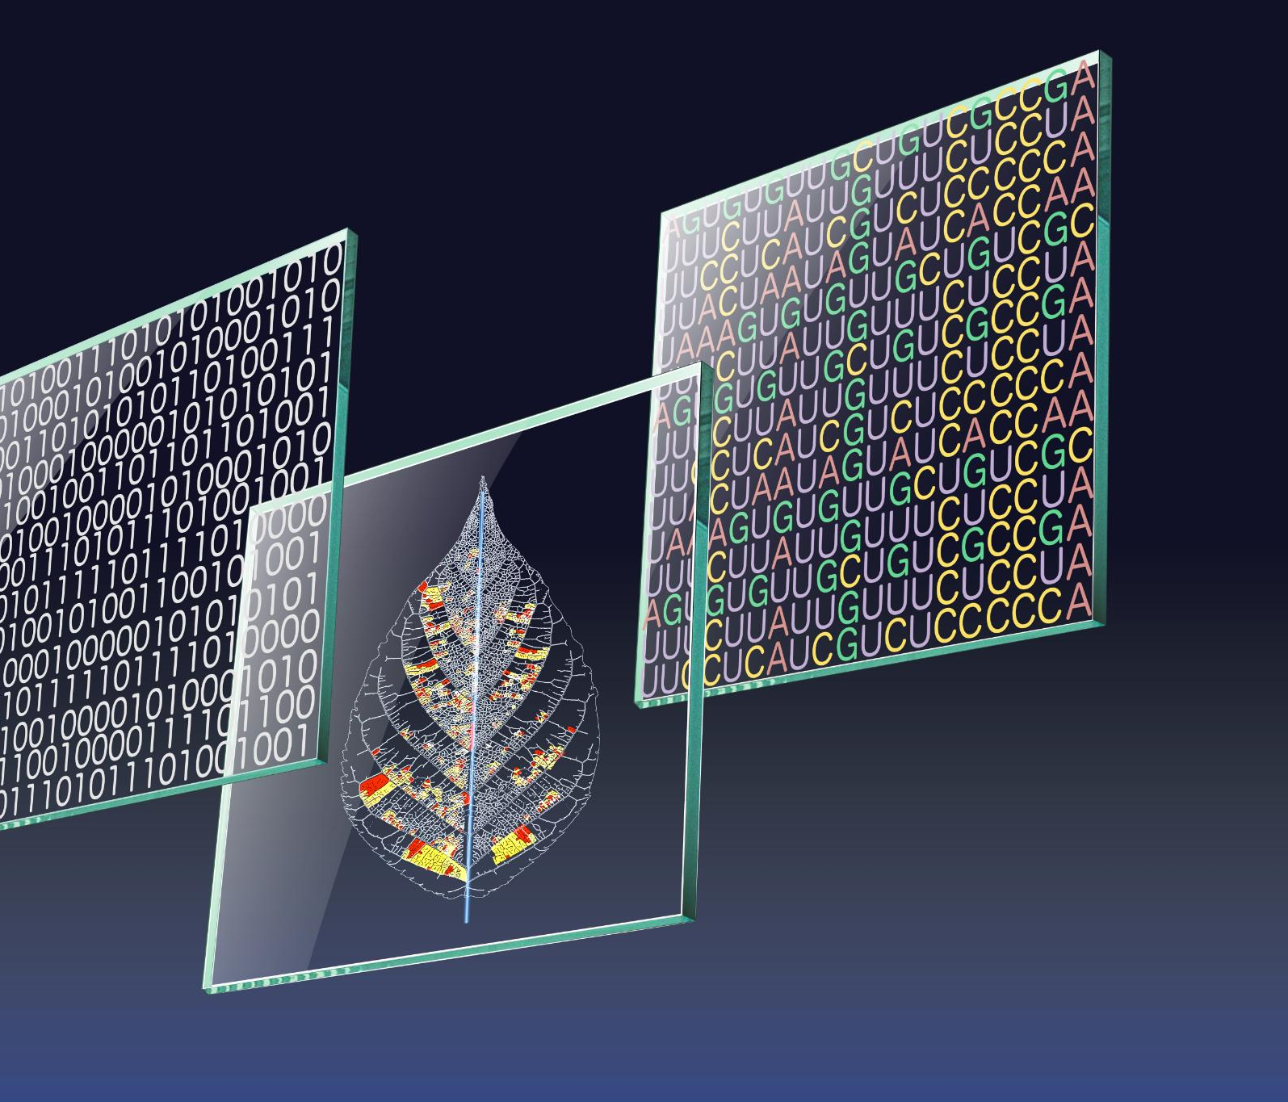
Density-Based Detection and Local Outlier Factor
Local Density Comparison
Density-based methods detect outliers by comparing data point concentrations in local regions of feature space.
Local Outlier Factor Concept
LOF measures how isolated a point is relative to its neighbors, capturing contextual anomalies effectively.
Challenges of LOF Method
LOF's performance depends on neighborhood size and suffers in high-dimensional spaces, requiring careful parameter tuning.
Notes:
--- This slide references information from the following file: https://scikit-learn.org/stable/modules/outlier_detection.html Density-based methods identify outliers by comparing the local concentration of data points in different regions of the feature space. The Local Outlier Factor (LOF) is a prominent example that measures how isolated a point is relative to its neighbors. Rather than relying on a global notion of normality, LOF evaluates local neighborhoods, allowing it to detect contextual anomalies that may be missed by global methods. For instance, a transaction amount that is typical for one customer segment may be highly unusual for another. LOF captures this nuance by adapting to local density variations. Despite its conceptual appeal, LOF has practical limitations. Its performance depends heavily on the choice of neighborhood size, often denoted by k. Too small a k can make the method unstable and sensitive to noise, while too large a k can wash out local structure. Additionally, like many distance- and density-based algorithms, LOF suffers in high-dimensional spaces where distances become less informative. These challenges mean that LOF should be used with care, accompanied by robustness checks and parameter sensitivity analysis. When applied thoughtfully, it can provide valuable insights into local structure, but it is not a universal solution.

Slide 12
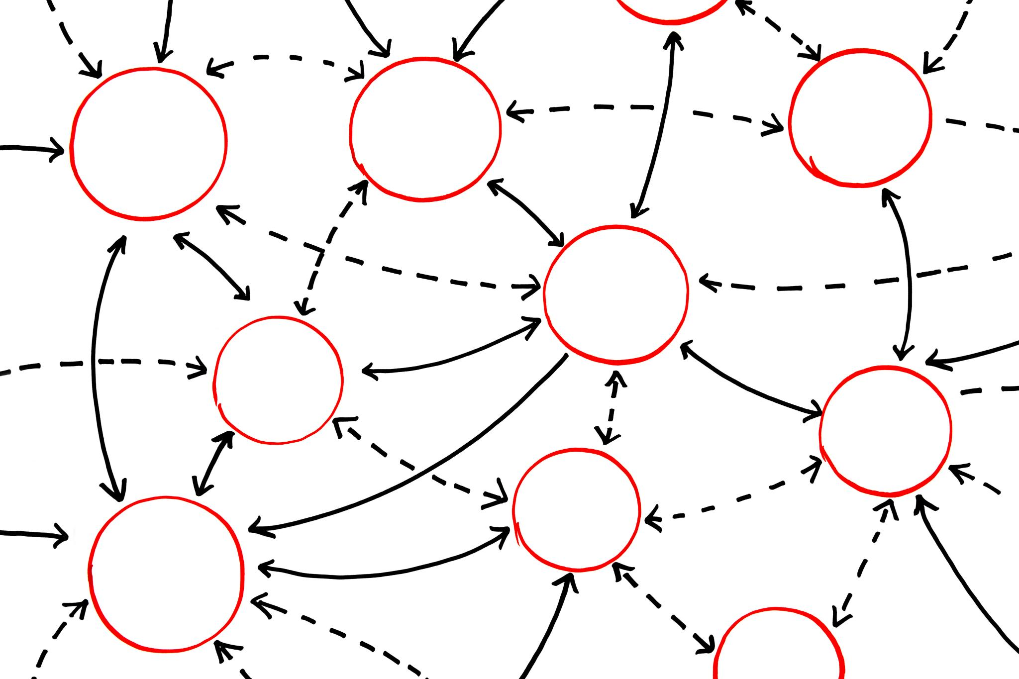
Isolation Forests and Partition-Based Logic
Core Isolation Principle
Isolation Forests detect anomalies by isolating data points through random partitioning rather than modeling normal behavior.
Scalability and Efficiency
The approach scales well to large, high-dimensional datasets with efficient computation and weak assumptions.
Parameter Sensitivity
Performance depends on the contamination parameter, reflecting expected outlier proportion, influencing detection results.
Use in Analytical Strategy
Best used as part of broader strategy including validation, comparison, and interpretation for meaningful insights.
Notes:
--- This slide references information from the following file: https://scikit-learn.org/stable/modules/outlier_detection.html Isolation Forests represent a different philosophy of outlier detection that avoids explicit modeling of normal behavior. Instead of estimating density or distance, they exploit the idea that anomalies are easier to isolate through random partitioning of the data. By recursively splitting the feature space using randomly selected variables and split points, Isolation Forests create trees in which outliers tend to have shorter average path lengths from the root. This approach scales well to large datasets and performs effectively in high-dimensional settings. It also makes relatively weak assumptions about the underlying data distribution. However, Isolation Forests are not entirely assumption-free. They require the analyst to specify a contamination parameter that reflects the expected proportion of outliers in the data. This choice can substantially influence results, especially when the true prevalence of anomalies is unknown. Moreover, while the method is computationally efficient, its outputs are still heuristic scores rather than definitive labels. As with other unsupervised methods, Isolation Forests are most valuable when used as part of a broader analytical strategy that includes validation, comparison across methods, and substantive interpretation.

Slide 13
Probabilistic and Applied Perspectives
Notes:
--- This slide references information from the following file: https://arods-docs.site44.com/reject.pptx Probabilistic Scoring and Local Outlier Probabilities, Filtering, PRIDIT-Style Methods, and Screening Logic, Caveats, Sensitivity, and Open Research Questions

Slide 14
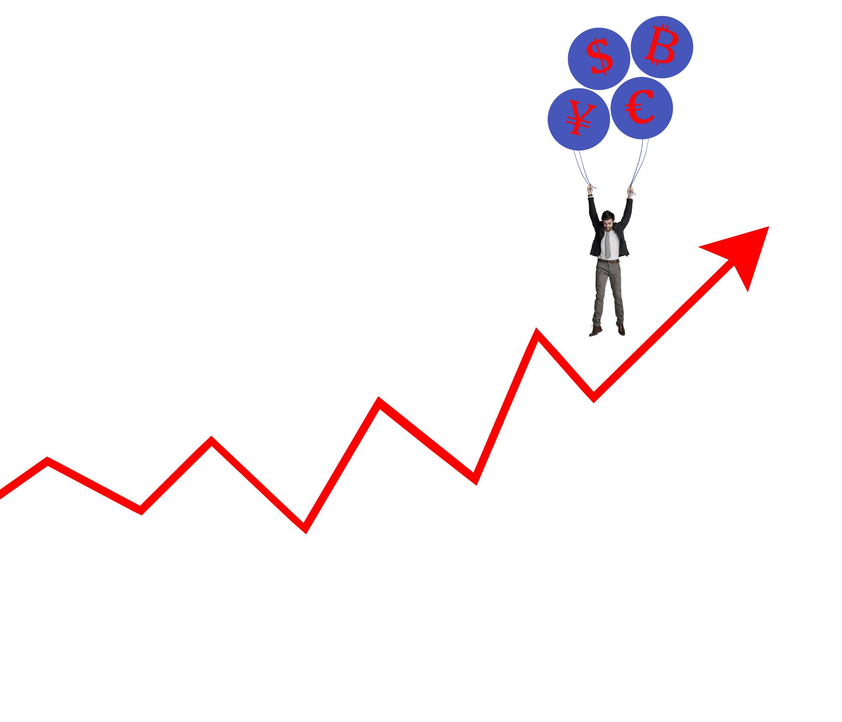
Probabilistic Scoring and Local Outlier Probabilities
Probabilistic Outlier Scoring
Scores reflect the likelihood of data points being outliers based on local data structure and risk.
Prioritization in Applied Settings
Probabilistic scores help rank cases by risk, aiding efficient resource allocation in audits and investigations.
Decision Making with Uncertainty
These methods support flexible thresholds and consider cost-benefit trade-offs, emphasizing uncertainty over binary decisions.
Limitations of Probabilistic Interpretation
Probabilistic scores depend on model assumptions and approximations, aiding communication rather than exact truth.
Notes:
--- This slide references information from the following file: https://arods-docs.site44.com/reject.pptx Probabilistic approaches to outlier detection aim to express abnormality in terms of likelihood or risk rather than binary classification. Methods such as Local Outlier Probabilities produce scores that can be interpreted as the probability that an observation is an outlier given the local structure of the data. This framing is particularly useful in applied settings where the goal is prioritization rather than definitive labeling. In audit and forensic contexts, analysts often need to rank cases by risk to allocate limited investigative resources efficiently. Probabilistic scores support this workflow by enabling flexible thresholds and sensitivity analysis. They also integrate more naturally with decision-making processes that weigh costs and benefits asymmetrically. For example, missing a true fraud case may be far more costly than investigating a false alarm. By emphasizing probabilities rather than hard decisions, these methods encourage analysts to think in terms of uncertainty and trade-offs. However, probabilistic interpretations should not be taken too literally, as they still depend on modeling assumptions and local approximations. Their strength lies in communication and prioritization rather than precise probabilistic truth.

Slide 15
Filtering, PRIDIT-Style Methods, and Screening Logic
Outlier Detection as Filtering
Outlier detection acts as a filtering mechanism, prioritizing cases for further review rather than predicting outcomes.
PRIDIT Composite Scoring
PRIDIT methods combine multiple weak signals into a robust composite score for identifying relevant anomalies.
Screening Logic and Transparency
Screening emphasizes transparency and interpretability, helping practitioners understand flagged cases and accept false positives.
Notes:
--- This slide references information from the following file: https://arods-docs.site44.com/reject.pptx In many applied domains, outlier detection functions as a filtering or screening mechanism rather than a predictive model. PRIDIT-style methods exemplify this perspective by combining multiple weak signals into a composite score that highlights observations warranting attention. These approaches are designed to be robust to label noise and to operate effectively when no single variable provides a clear signal of abnormality. Rather than optimizing predictive accuracy, they focus on ranking and prioritization. This orientation aligns well with audit, compliance, and investigative workflows, where the objective is to identify a manageable subset of cases for further review. Screening methods acknowledge that false positives are inevitable and acceptable, provided they help surface true issues efficiently. They also emphasize transparency and interpretability, allowing practitioners to understand why a case was flagged. Viewing outlier detection through the lens of filtering reinforces the idea that these techniques are embedded within broader institutional processes and should be evaluated accordingly.

Slide 16

Caveats, Sensitivity, and Open Research Questions
Sensitivity to Modeling Choices
Outlier detection is highly affected by choices like feature selection, correlation, and scaling, impacting flagged observations.
Impact of Noisy and Correlated Variables
Noisy attributes can cause false anomalies, and correlated variables can distort distance and density measurements.
Open Questions in Outlier Handling
Key research questions include optimal predictor number, noise impact, and best strategies for treating flagged outliers.
Importance of Robust and Transparent Approach
A cautious, transparent, and robust approach is essential, prioritizing substantive understanding over automated methods.
Notes:
--- This slide references information from the following file: https://arods-docs.site44.com/reject.pptx Outlier detection methods are highly sensitive to modeling choices, including feature selection, correlation structure, and scaling. Small changes in the number or definition of predictors can lead to large differences in which observations are flagged. Correlated variables can distort distance and density measures, while noisy attributes may generate spurious anomalies. These sensitivities highlight the importance of careful data preparation and diagnostic analysis. They also motivate ongoing research into questions such as the optimal number of predictors for outlier detection, the impact of attribute noise, and the appropriate treatment of flagged observations. Should outliers be removed, down-weighted, or investigated? The answer depends on the analytical goal and the consequences of different errors. There is no universally correct strategy. Recognizing these caveats encourages a cautious and reflective approach to outlier detection, one that values robustness, transparency, and substantive understanding over mechanical application of algorithms.

