Slide 1

Identification of Misclassified
Medicaid Audits
A.E. Rodriguez
&
M. F. Ahmed

Slide 2
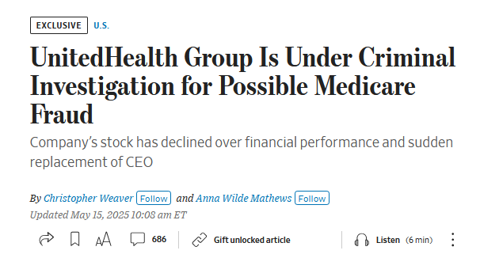
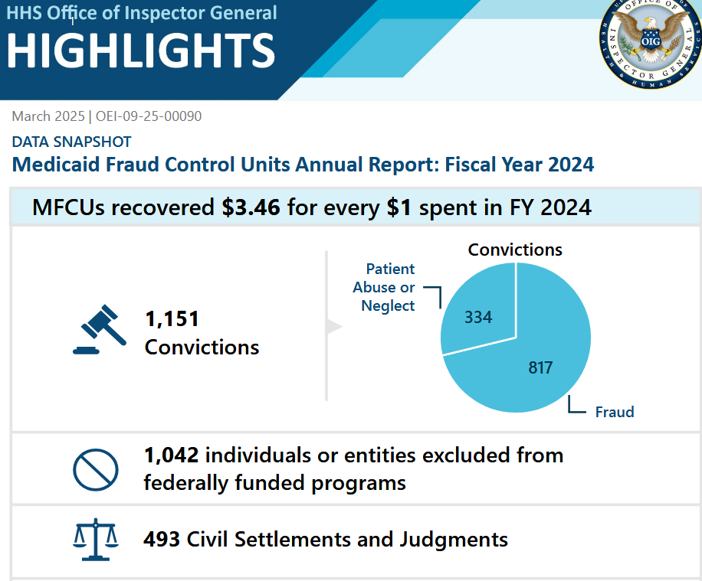

Slide 3
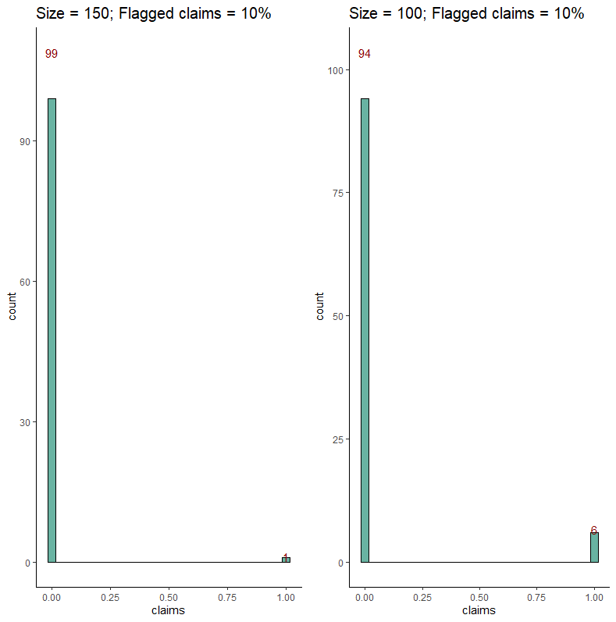

Slide 4
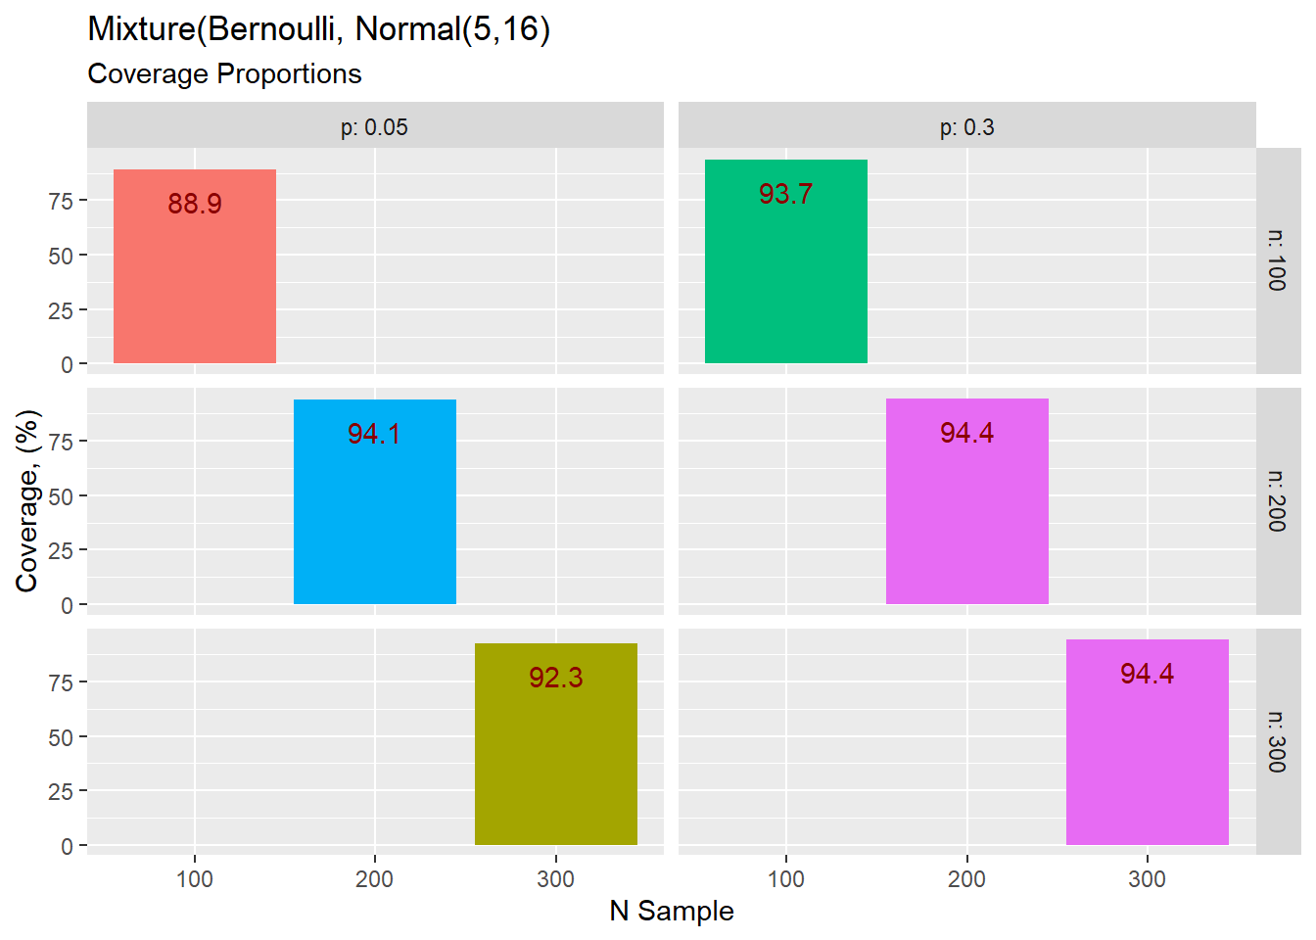

Slide 5
Rodriguez, A. E., & Kucsma, K. (2023). Appraising Audit Error in Medicaid Audits. International Journal of Accounting and Financial Reporting.
Hausman , J. A., Abrevaya, J., & Scott-Morton, F. M. (1998). Misclassification of the
Dependent Variable in a Discrete-Response Setting. Journal of Econometrics
Brody, R. G., DeZoort, F. T., Gupta, G., & Hood, M. B. (2022). The Effects of Cognitive Bias on Fraud Examiner Judgments and Decisions. Journal of Forensic Accounting Research.
Walauskis, M. A., & Khoshgoftaar, T. M. (2025). Unsupervised Label Generation for Severely Imbalanced Fraud Data. Journal of Big Data.

Slide 6
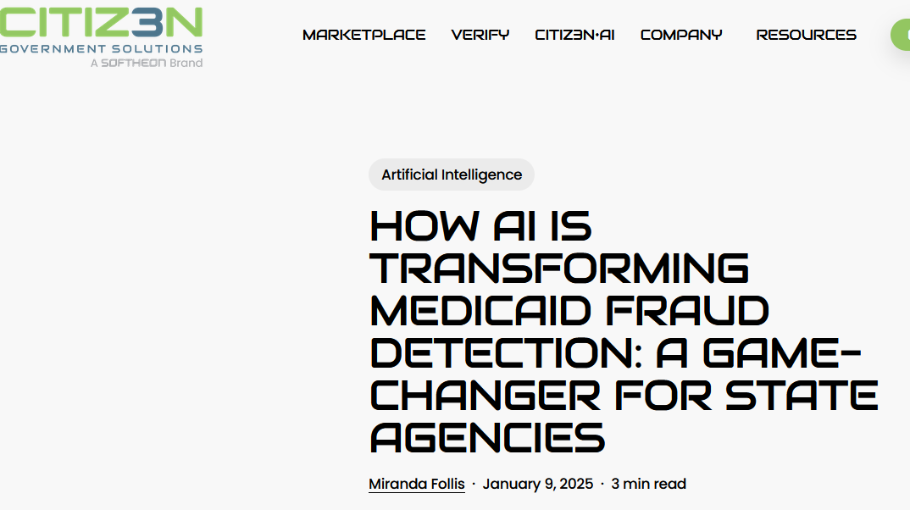
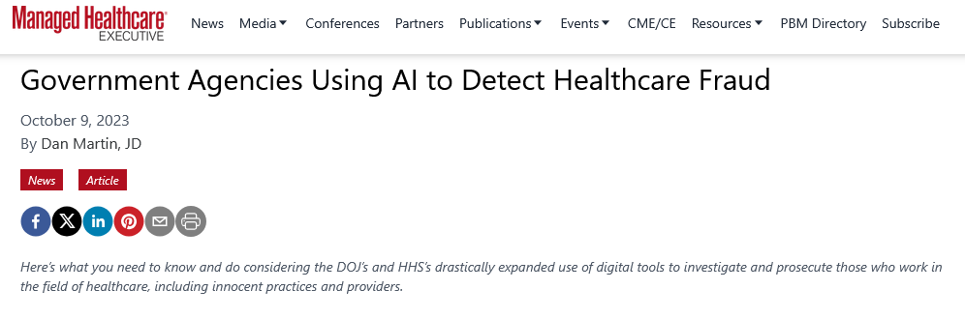
FILTERS ARE EVERYWHERE

Slide 7
Noisy Data
Cleanseddata
Learning
algorithm
Filter
Concentrated data

Slide 8
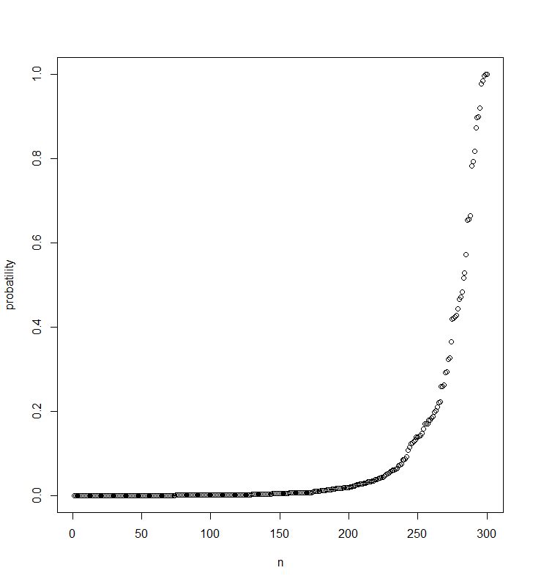
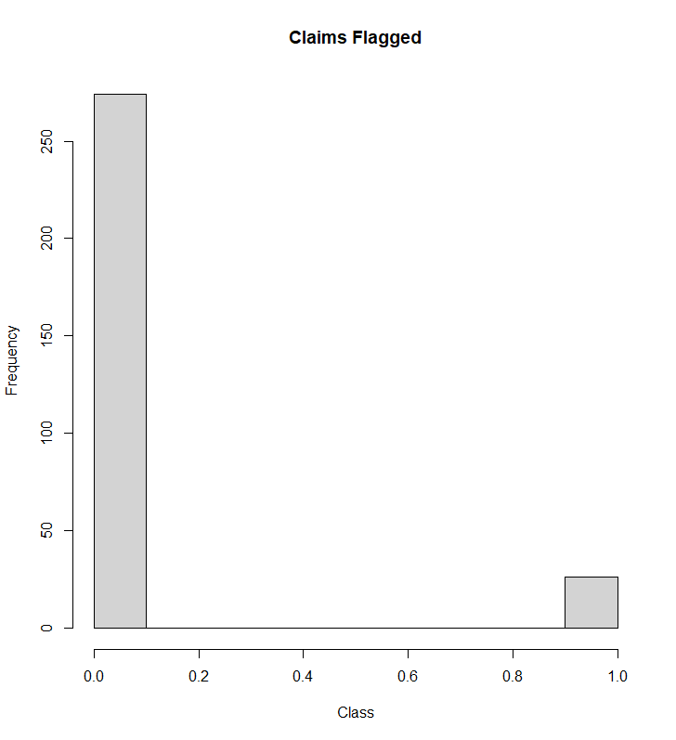

Table: Audit Features
V1 V2 V3 V4 V5
------- -------- -------- -------- --------
0.891 0.629 1.154 0.449 -1.004
0.030 -0.233 -0.383 -1.359 -0.704
2.486 1.711 0.443 0.738 0.413
0.661 1.324 0.603 0.714 0.403
0.342 -0.396 1.024 0.222 0.288
0.686 -0.354 -1.035 0.021 -0.779
xb $=$ -5.5 + V1 + V2 + V3 + V4 + V5
p = 1/(1 + exp(-xb))
var = 1, cov = 0.65

Slide 9


Slide 10
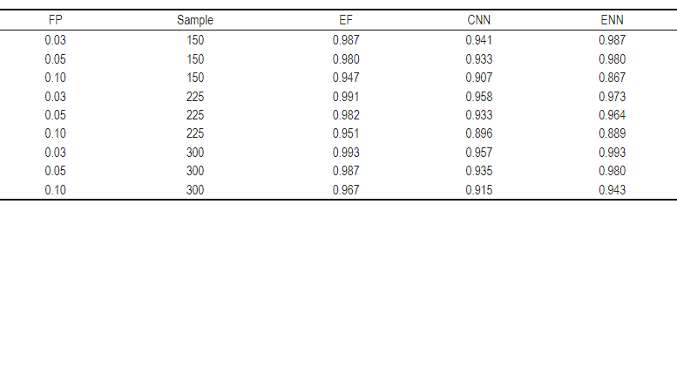

Slide 11
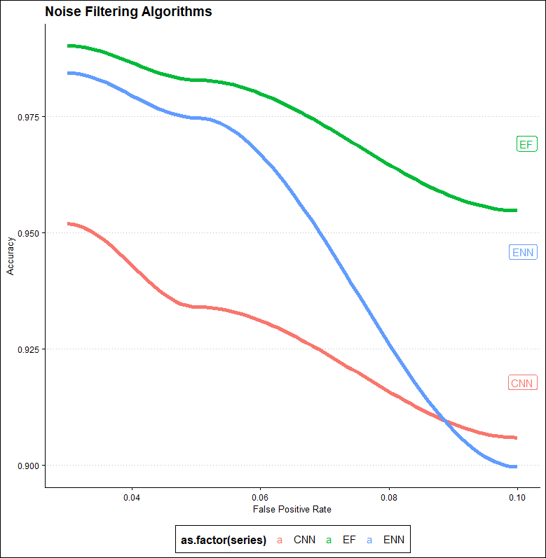

Slide 12
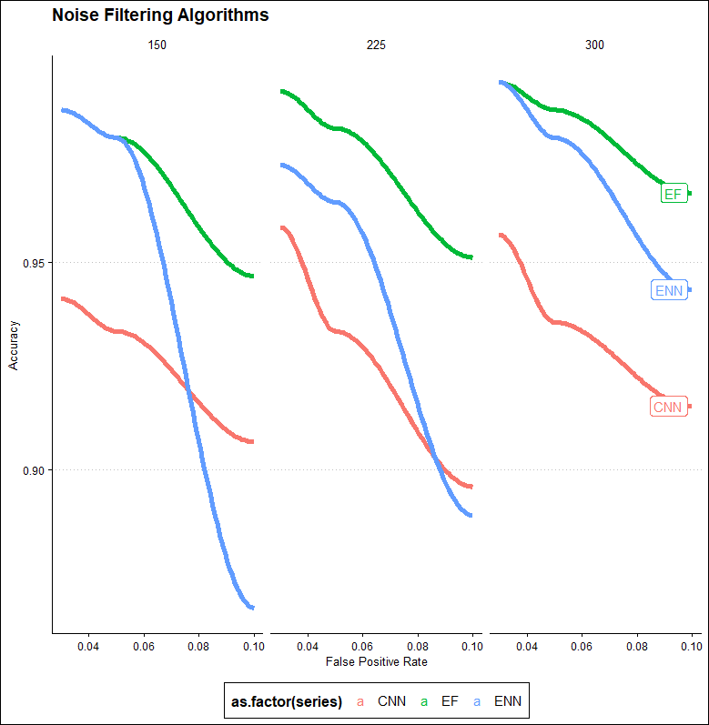

Slide 13
CAVEATS or OPPORTUNITIES
other methods (inter alia):
semi-supervised methods
isolation forests
PRIDIT
local outlier probabilities

Slide 14
REMAINING QUESTIONS
FURTHER WORK?
fewer predictors? Optimal number of predictors?
the impact of attribute noise
The sensitivity of the variance and covariance between predictors on accuracy.

Slide 15

A copy of the paper can be found here:
https://arods-docs.site44.com/LabelNoise_AER_053025.pdf
A copy of the slides can be found here:
https://arods-docs.site44.com/reject.html
Thank you
arodriguez@newhaven.edu

