Slide 1
Weighted Indexes in Time Series Analysis
A.E. Rodriguez

Slide 2
Why Index?
👉 You want a single summary measure over time

Slide 3
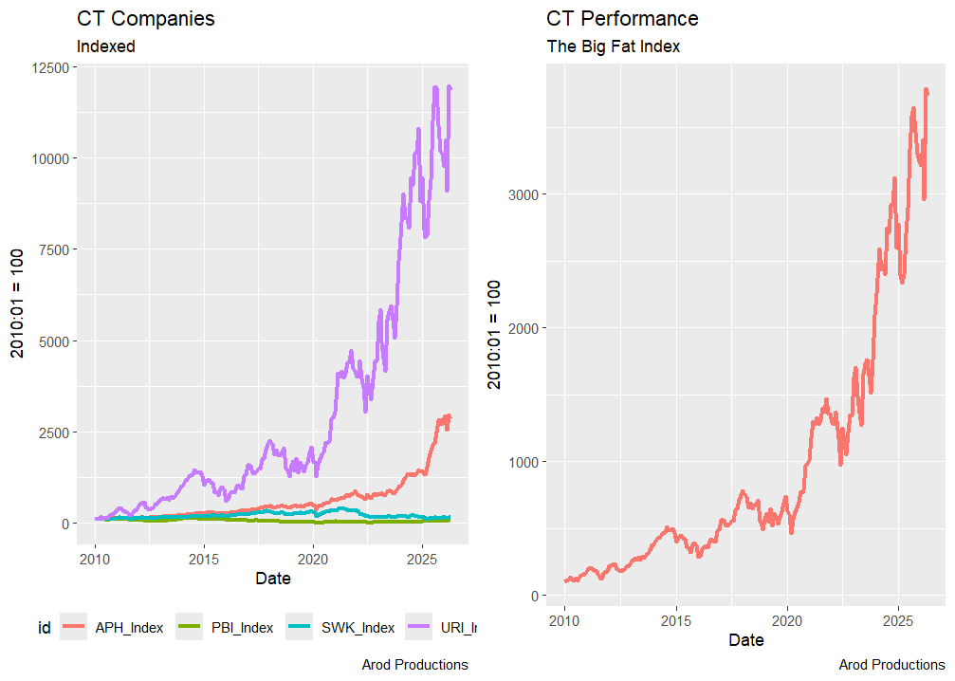

Slide 4
Example Setup
Housing, Food, Entertainment, Performance
Price Levels differ; therefore Price changes differ
In the calculation of an Index Size (Levels) matters therefore Weights matter

Slide 5
Weighted vs Unweighted
Unweighted average may mislead
Weighting may reflect importance or contribution

Slide 6
Aggregation Example (Setup)
Component A: 100 → 200 (100% growth)
Component B: 1000 → 1100 (10% growth)
Goal: compare aggregation methods

Slide 7
Method 1: Sum of Ratios (Wrong)
Compute growth first
0.5×100% + 0.5×10% = 55%
Treats components equally
Ignores size differences

Slide 8
Method 2: Ratio of Sums (Correct)
Aggregate levels first
t-1 total = 1000+ 100 = 1100
t-1 total = 100 + 100 = 200
t total = 1300
t-original = 1100
Growth = (1300-1100)/1100 = 18.18%
Reflects economic size

Slide 9
Comparison
Method 1: 55%
Method 2: 18.18%
Large discrepancy
Why? Nonlinearity + weighting

Slide 10

Thank you
arodriguez@newhaven.edu

